Slide 1
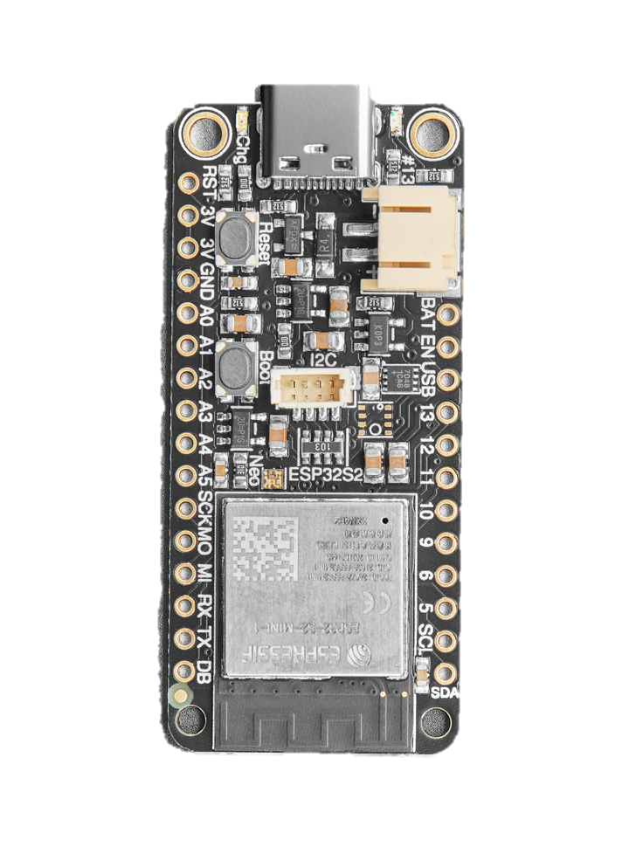
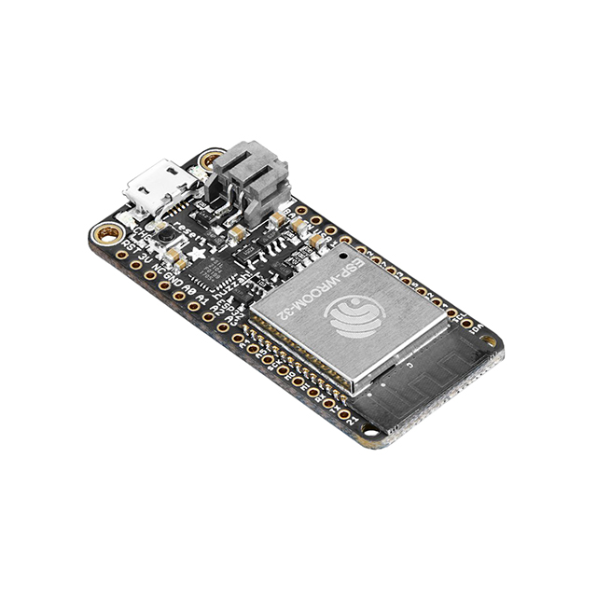
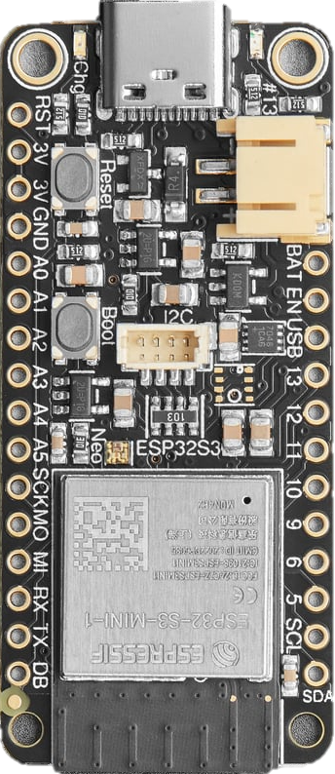
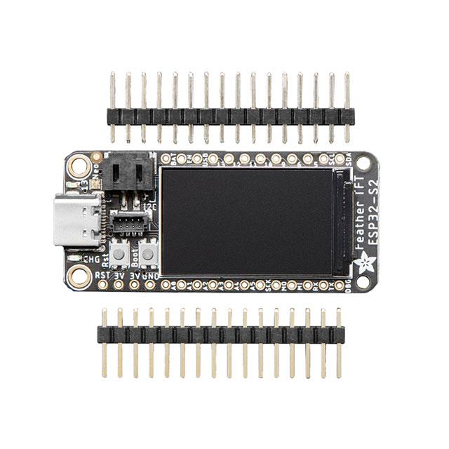
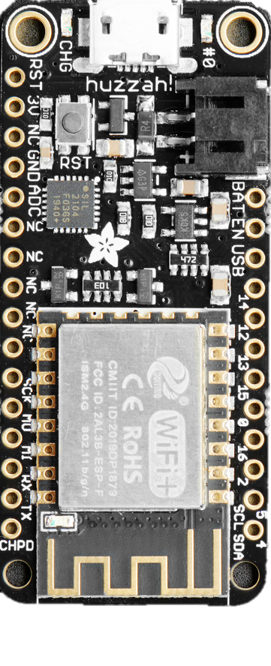
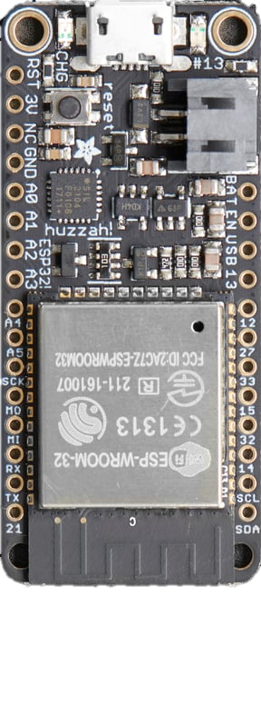
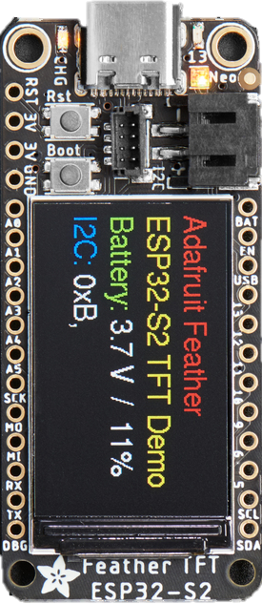
Adafruit ESP32-S2 | $17.50
240 MHz single core Tensilica LX7
802.11b/g/n WiFi
No Bluetooth
4MB Flash
2MB PSRAM
Native USB
https://www.adafruit.com/product/5000
Adafruit ESP32-S3 | $17.50
240 MHz dual core Tensilica LX7
802.11b/g/n WiFi
Bluetooth (Classic/BLE)
4MB Flash
2MB PSRAM
Native USB
https://www.adafruit.com/product/5000
Adafruit ESP32 | $19.95
240 MHz dual core Tensilica LX6
802.11b/g/n WiFi
Bluetooth (Classic/BLE)
4MB Flash
520KB SRAM
https://www.adafruit.com/product/3405
Adafruit ESP8266 | $14.95
80 MHz Tensilica L106
WiFi 4
No Bluetooth
4MB Flash
160KB SRAM
https://www.adafruit.com/product/2821
Adafruit ESP32-S2 TFT
$24.94

Slide 2
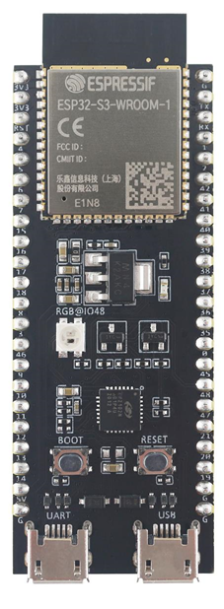
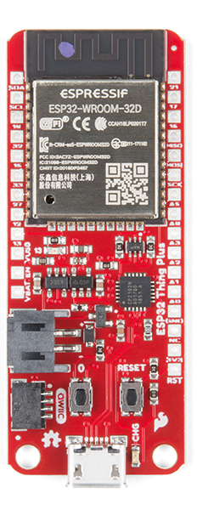
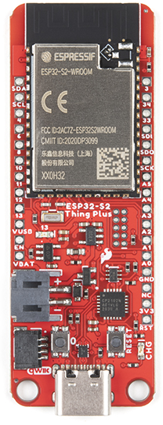
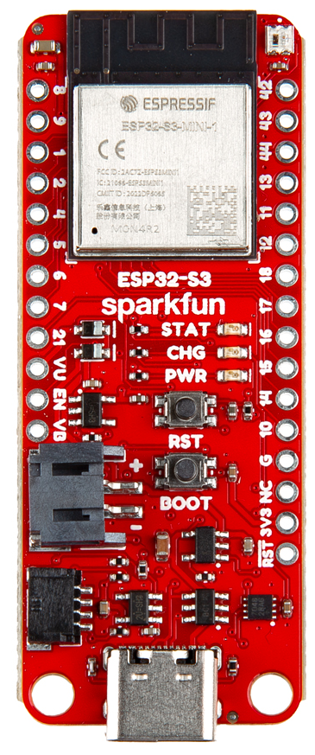
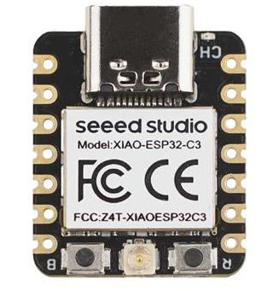
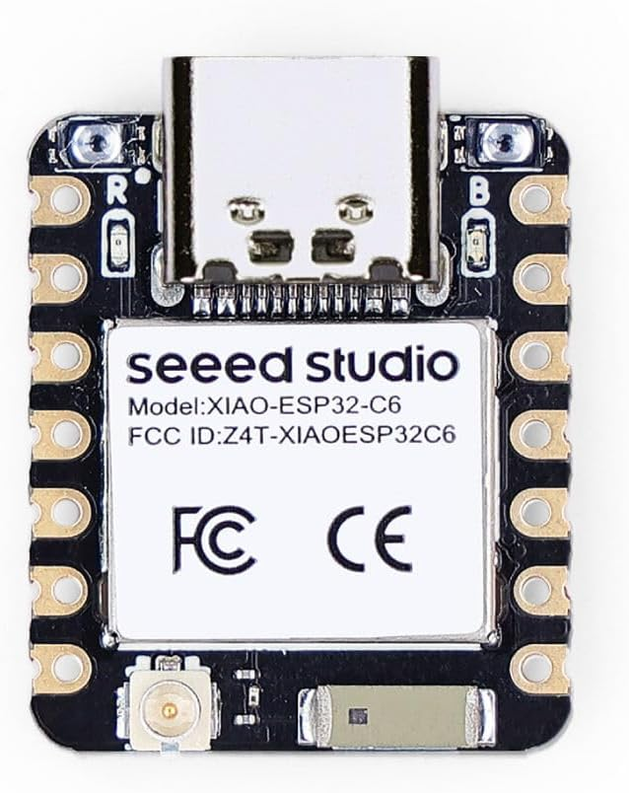
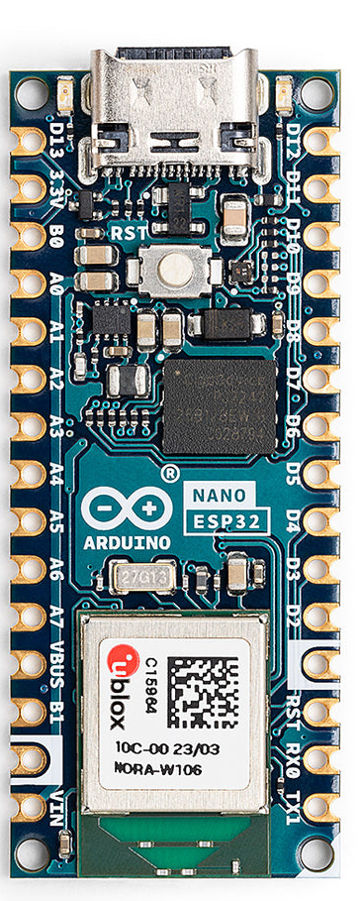
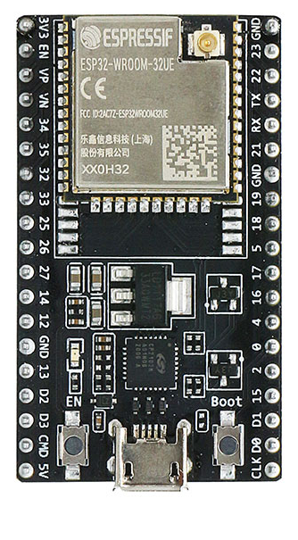
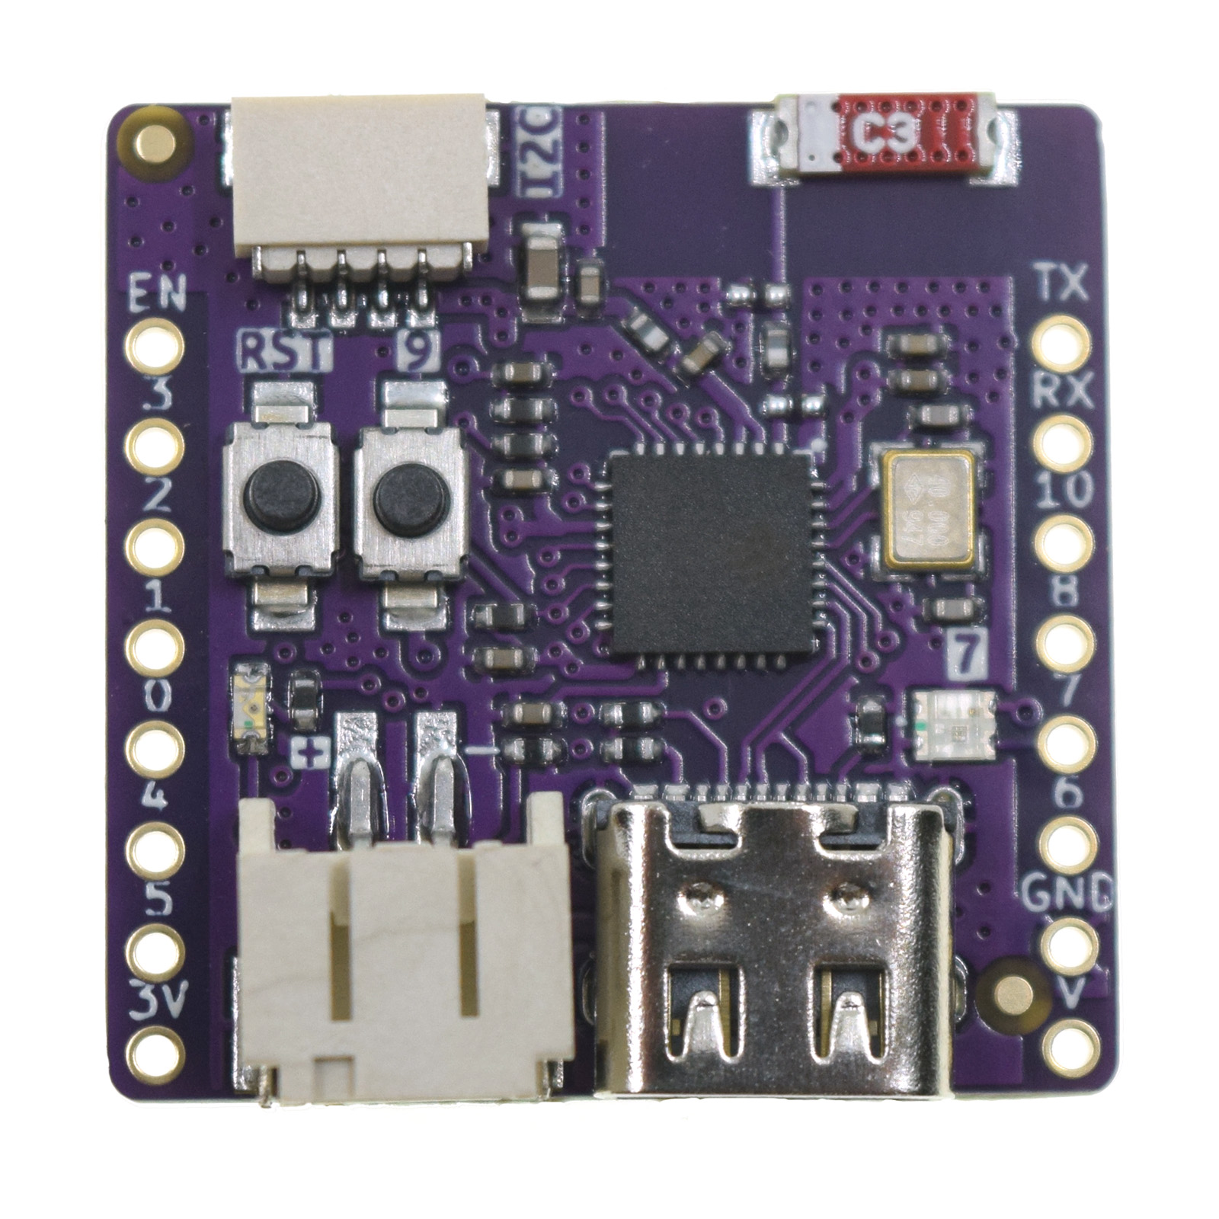
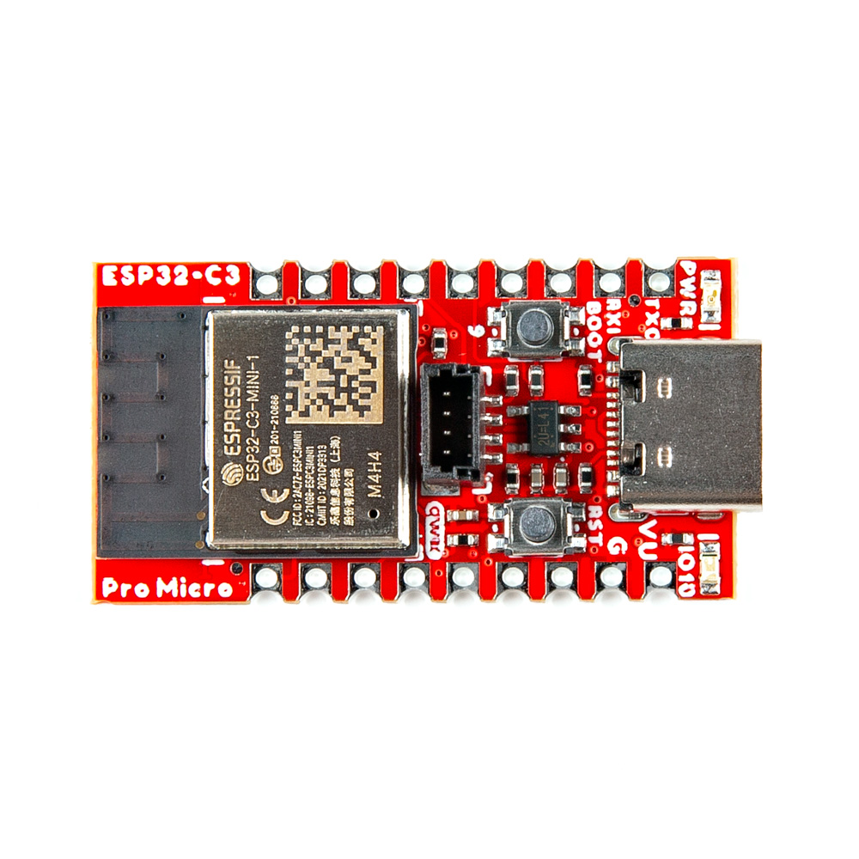
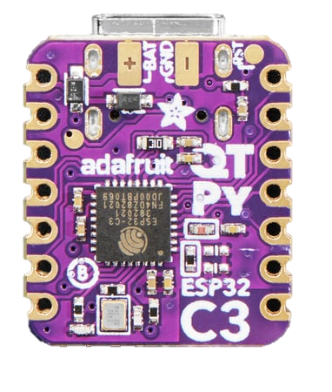
Seeed Studio ESP32-C3
$4.99
Seeed Studio ESP32C6
$11.99
Espressif ESP32-S3 Devkit
$15
Arduino Nano ESP32-S3
$20
Adafruit ESP32-S2 TFT
$24.95
Sparkfun Thing+ ESP32
$22.50
Sparkfun Thing+ ESP32-S2
$21.50
Sparkfun Thing+ ESP32-S3
$19.95
Espressif ESP32 Devkit
$10
Wemos Lolin ESP32-C3 Pico
$5.46
Sparkfun Pro Micro ESP32-C3
$9.95
Adafruit QT Py ESP32-C3
$9.95
Adafruit ESP32
$19.95
Adafruit ESP32-S2
$17.50
Adafruit ESP32-S3
$17.50

Slide 3
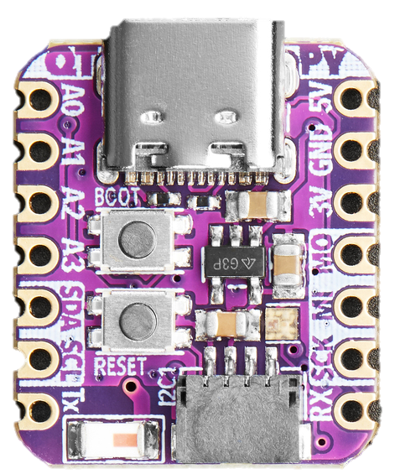
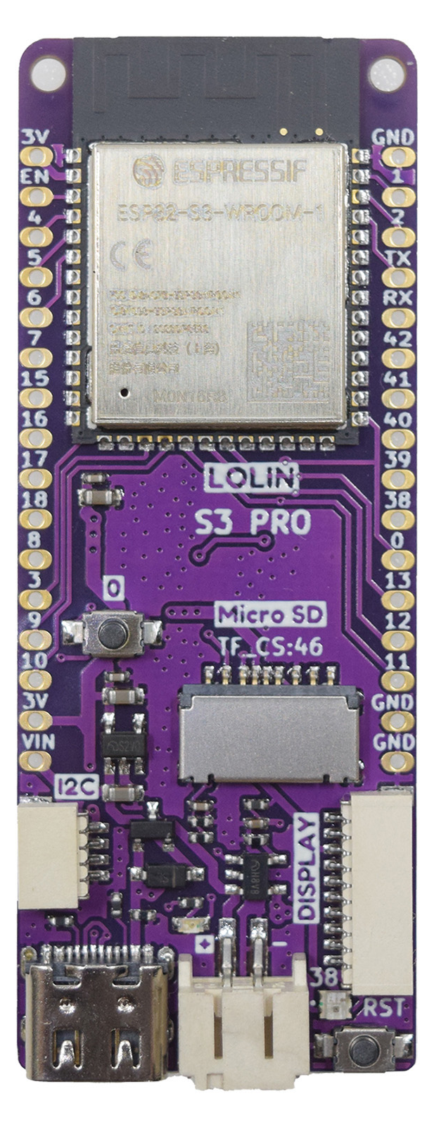
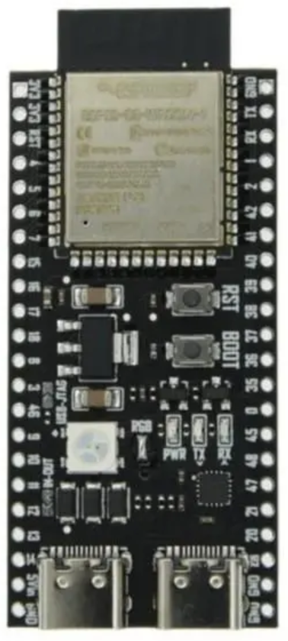
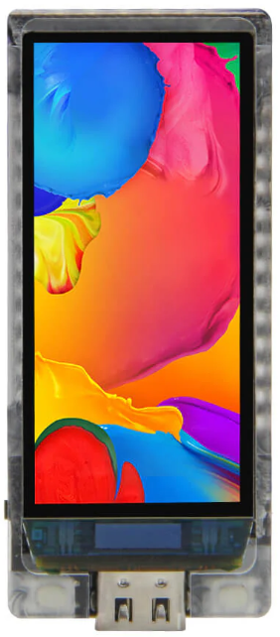
Seeed Studio ESP32-C3
$4.99
Adafruit QT Py ESP32-C3
$9.95
Seeed Studio ESP32C6
$11.99
Wemos Lolin ESP32-C3 Pico
$5.46
Adafruit QT Py ESP32-S3 $12.50
Espressif ESP32-S3 Devkit
$15
Arduino Nano ESP32-S3
$20
Adafruit ESP32-S2 TFT
$24.95
Sparkfun Thing+ ESP32
$22.50
Sparkfun Thing+ ESP32-S2
$21.50
Sparkfun Thing+ ESP32-S3
$19.95
Sparkfun Pro Micro ESP32-C3
$9.95
Espressif ESP32 Devkit
$10
Wemos Lolin ESP32-S3
$7.09
Generic ESP32-S3
$0.99
Lilygo T-Disp S3 AMOLED
$33.98
Adafruit ESP32
$19.95
Adafruit ESP32-S2
$17.50
Adafruit ESP32-S3
$17.50

Slide 4
Seeed Studio ESP32-C3
$4.99
Adafruit QT Py ESP32-C3
$9.95
Seeed Studio ESP32C6
$11.99
Wemos Lolin ESP32-C3 Pico
$5.46
Adafruit QT Py ESP32-S3 $12.50
Espressif ESP32-S3 Devkit
$15
Arduino Nano ESP32-S3
$20
Adafruit ESP32-S2 TFT
$24.95
Sparkfun Thing+ ESP32
$22.50
Sparkfun Thing+ ESP32-S2
$21.50
Sparkfun Thing+ ESP32-S3
$19.95
Sparkfun Pro Micro ESP32-C3
$9.95
Espressif ESP32 Devkit
$10
Wemos Lolin ESP32-S3
$7.09
Generic ESP32-S3
$0.99
Lilygo T-Disp S3 AMOLED
$33.98
Adafruit ESP32
$19.95
Adafruit ESP32-S2
$17.50
Adafruit ESP32-S3
$17.50

Slide 5
Seeed Studio ESP32-C3
$4.99
Adafruit QT Py ESP32-C3
$9.95
Wemos Lolin ESP32-C3 Pico
$5.46
Adafruit QT Py ESP32-S3 $12.50
Espressif ESP32-S3 Devkit
$15
Arduino Nano ESP32-S3
$20
Adafruit ESP32-S2 TFT
$24.95
Sparkfun Thing+ ESP32
$22.50
Sparkfun Thing+ ESP32-S2
$21.50
Sparkfun Thing+ ESP32-S3
$19.95
Sparkfun Pro Micro ESP32-C3
$9.95
Espressif ESP32 Devkit
$10
Wemos Lolin ESP32-S3
$7.09
Generic ESP32-S3
$0.99
Lilygo S3 AMOLED
$33.98
Adafruit ESP32
$19.95
Adafruit ESP32-S2
$17.50
Adafruit ESP32-S3
$17.50

